Slide 1
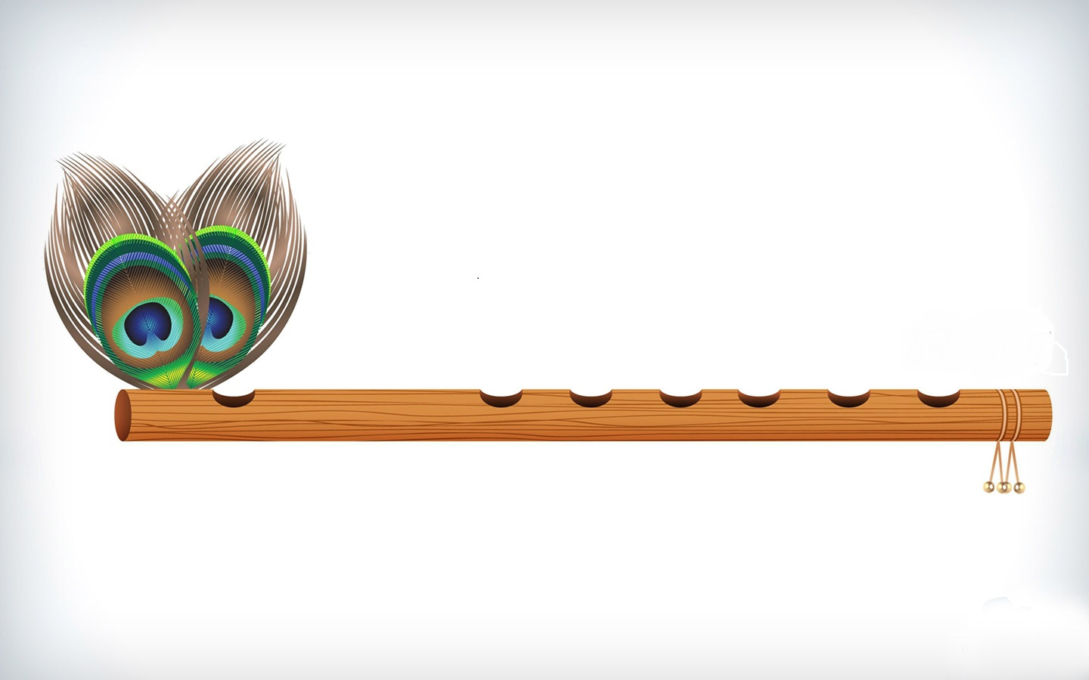
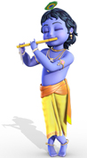
KRISHNA SAFARI The Magical Voyage of Murliwala
BY: Sonali Chawla (AU124060202002P)
Vinisha Sharma (AU120060301018P)

Slide 2

INTRODUCTION
extension to our project KRISHNA SAFARI-A 3D GAME for android users which was done in the fifth semester of our BCA program.
Current sinking ideology of the people.
Game Based on Indian Mythology.
Covers various life events of Lord Krishna’s life.
Show the path of humanity to people.
Bring alive various episodes of the almighty Krishna.

Slide 3
OBJECTIVE
Teaching a lesson, “Burai par hamesha acchai ki jeet hoti hai”.
Promoting Indian mythology.
Challenging and improving mental and gaming skills.
Providing a joyful learning experience.
Competition to the players of all ages.
Self development.
Transmission of knowledge.

Slide 4
FEASIBILITY STUDY
ECONOMICAL FEASIBILITY:
Open source software: unity3d, blender, makehuman and oracle.
Supports various versions of android with graphics driver and audio driver.
This makes the game economically feasible.

Slide 5
FEASIBILITY STUDY
II. TECHNICAL FEASIBILITY:
All the inventories like interfaces and characters will be made by using softwares such as unity3d, blender, makehuman, oracle and Android.
These softwares are easy to use.
This makes the game technically feasible

Slide 6
FEASIBILITY STUDY
III. LEGAL FEASIBILITY:
Use open source softwares
Characters used are not copied from anywhere.
Scenes based on Lord Krishna’s life.
Any similarity to any person living or dead is purely coincidental.
Doesn’t uses the copyright of others

Slide 7
METHODOLOGY
Surveying current scenario
Game story
Softwares
Feasibility study
Designing characters and Elements for the game
Conceptualizing Scenes
Positioning Elements and Characters
Technical stride: Animation, audio, scripting the scenes and connecting scenes together
Switching between levels.
Connectivity to database.

Slide 8
PROPOSED TECHNOLOGY
UNITY 3D
BLENDER
MAKEHUMAN
ORACLE

Slide 9
VARIOUS LEVELS OF THE GAME
The game is divided into three levels.
LEVEL1- help Vasudeva ji to safely take Lord Krishna to Gokul village by crossing storming Yamuna river .
LEVEL 2-help Lord Krishna to collect Pitchers filled with butter to become strong and lift Govardhan Parvat.
LEVEL 3- help Lord Krishna to win carriage race

Slide 10
LEVEL 1

Slide 11
Details
To safe Lord Krishna’s life from his uncle Kansa, Vasudeva took little Krishna to Gokul village to Nanda’s home. To do so, he has to cross storming Yamuna river. So in this level, a player has to help Vasudeva to safely rescue baby Krishna.
FORMAT:
First level is divided into four in four laps.
In every lap, vasudeva ji has to cross ten wooden logs.
Multiplier will increase by 1x after every lap.
Touch screen to increase speed.
Collect snake ball after 2nd lap and get the help of sheshnaga.
Finish game in less than 125 seconds to get time bonus.

Slide 12
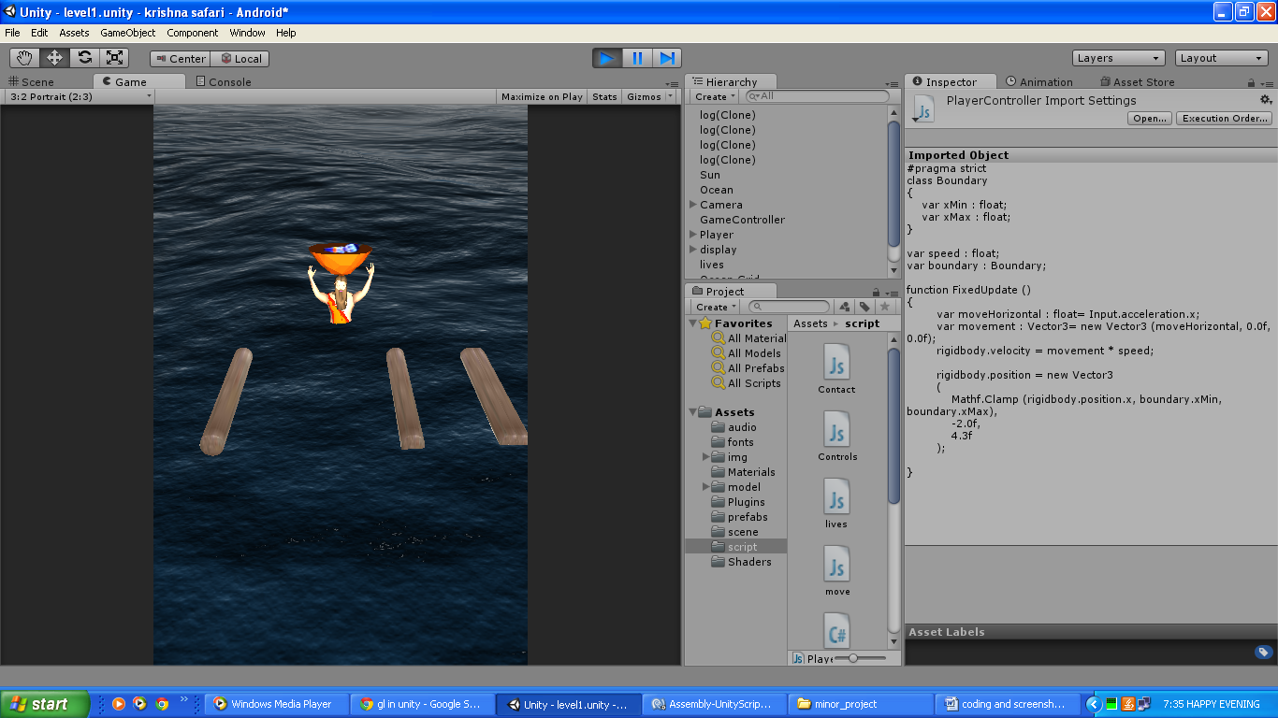
Level 1

Slide 13
LEVEL 2

Slide 14
Details
In this level help Krishna to collect pitchers filled with butter as much as he can in the given time, so as to finish the level.
FORMAT:
Swipe on the pitchers to crack them.
Hold yourself from swiping on the bombs.
For each pitcher cracked, a player gets +1 point and for each bomb exploded, -2 points are given.
Crack more than 20 pitchers in 15 seconds to finish the level.

Slide 15
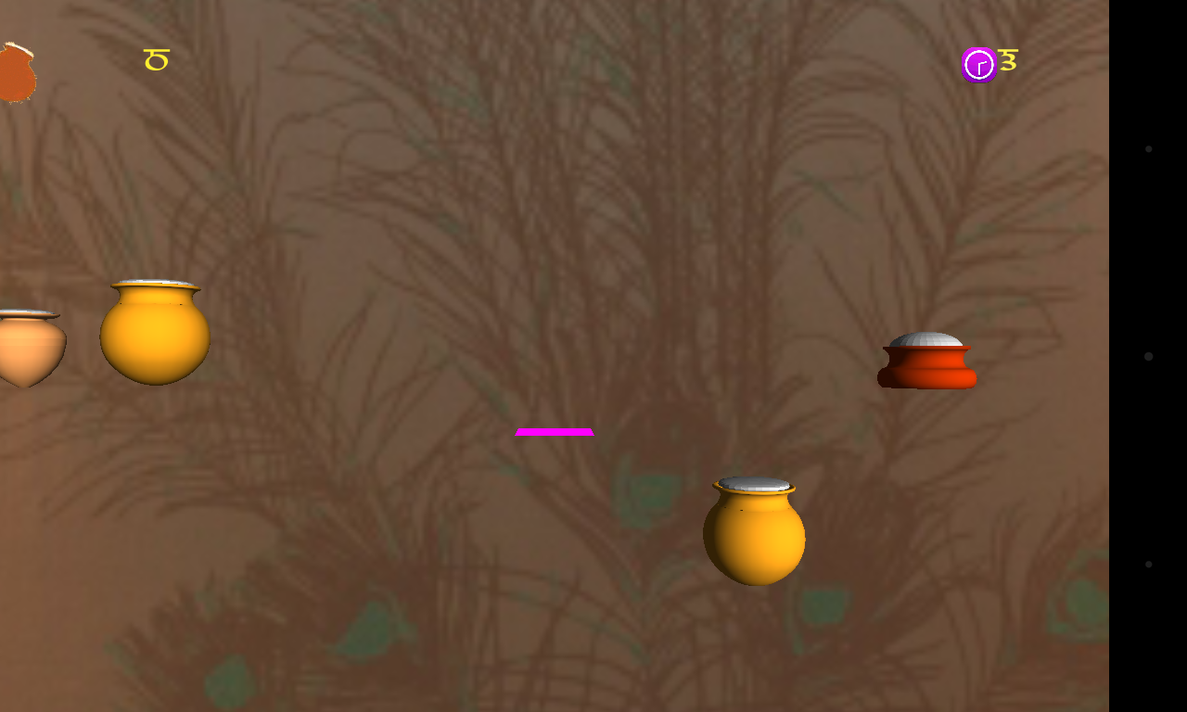
Level 2

Slide 16
LEVEL 3

Slide 17
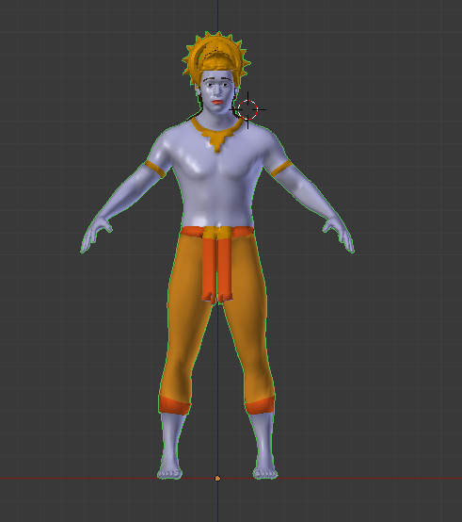
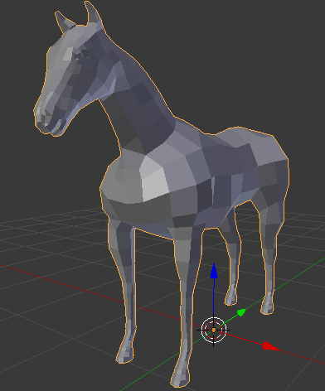
Details
In this level help Lord Krishna to win carriage race

Slide 18
PROGRESS REPORT
S. NO. | TASKS | STATUS
1 | Level 1 model design | completed
2 | Level 1 interface | completed
3 | Level 2 model design | completed
4 | Level 2 interface | completed
5 | Level 3 models | Half finished
6 | Level 3 interface | X
7 | Database connectivity | X
8 | Product release | X

Slide 19
THANK YOU

